Slide 1

MTRX ML Engineer
Etay Avayo - Home Assignment
Full project at https://github.com/vayoa/email_classification.

Slide 2

Business Challenge & Dataset
✉️ Mailboxes overflow with forums, promotions, spam, updates, social media, verification codes.
💽 Dataset:
Public dataset (categories only).
Added an importance column via simple keyword rules. Made it binary (important / not) to reduce subjectivity.
Risk: important emails get buried → poor productivity, worst clarity.
Objective: automatically categorize emails + detect importance → rag-enabled chatbot for batch Q&A.
Rules only seeded labels — we rely on our model's semantic finetuning so we're not just copying our rules.

Slide 3



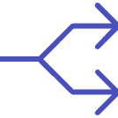
Architecture
Multitask ModernBERT Classifier
Encoder
ModernBERT
Multitask
Outperforms few-shot LLMs for subjective classification like importance → decoder is redundant.
Drop-in BERT replacement
Faster inference: one forward pass.
Faster inference.
Shared features: importance benefits from category signals.
Larger context window.
Shared ModernBERT encoder with two heads → cheap + fast.
Broader training corpus.

Slide 4
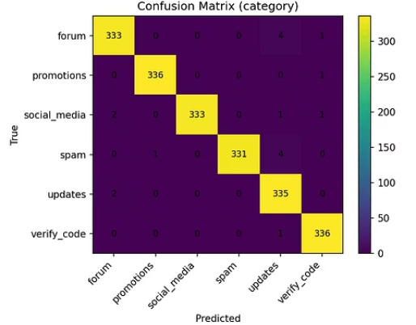
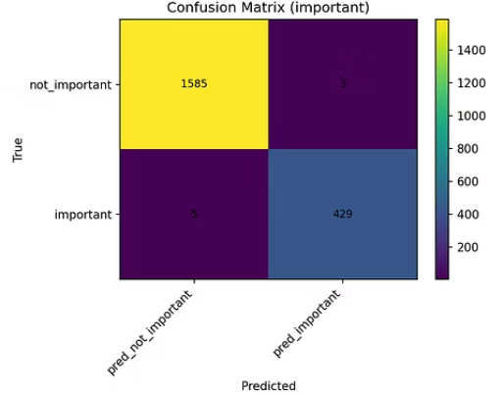
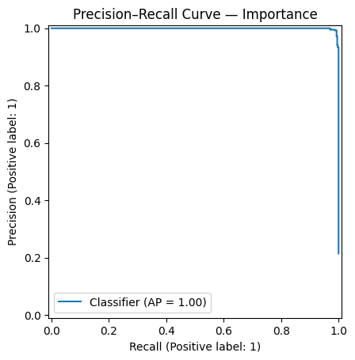
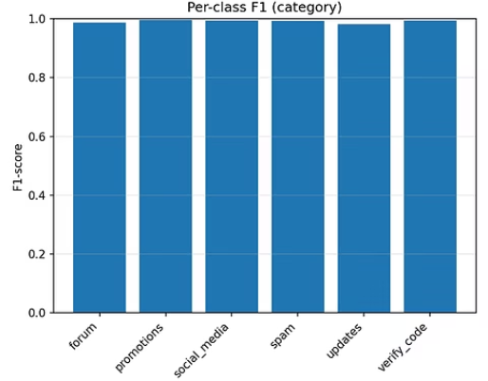
Evaluation
Results (Test Set)
Category classification:
Accuracy 99.1%, Macro F1 0.991.
Every class ≥ 0.98 F1 (e.g., Promotions 0.997, Verify Code 0.994).
Importance detection:
Accuracy 99.6%, F1 0.991.
ROC-AUC 0.9999, PR-AUC 0.9995.
Takeaway:The classifier is robust and trustworthy for both categorization and importance — it will rarely miss an important email, and rarely flag an unimportant one.

Slide 5




Indexer, Chatbot & Retrieval
From Classifier to Usable System
GMail
ChromaDB
Gemini
Gmail API limits 100 in batch → exploited for concurrency.
Stores text embeddings + metadata.
Gemini chosen for huge context size (~1m + free usage.
Enables filtered retrieval: “important promotions last week”, “verify codes from today”.
Each batch: ModernBERT classification + MiniLM embeddings in parallel.
Query tools replace traditional rag, allowing filtering based on classification.
Cuts indexing time ≈ in half.

Slide 6

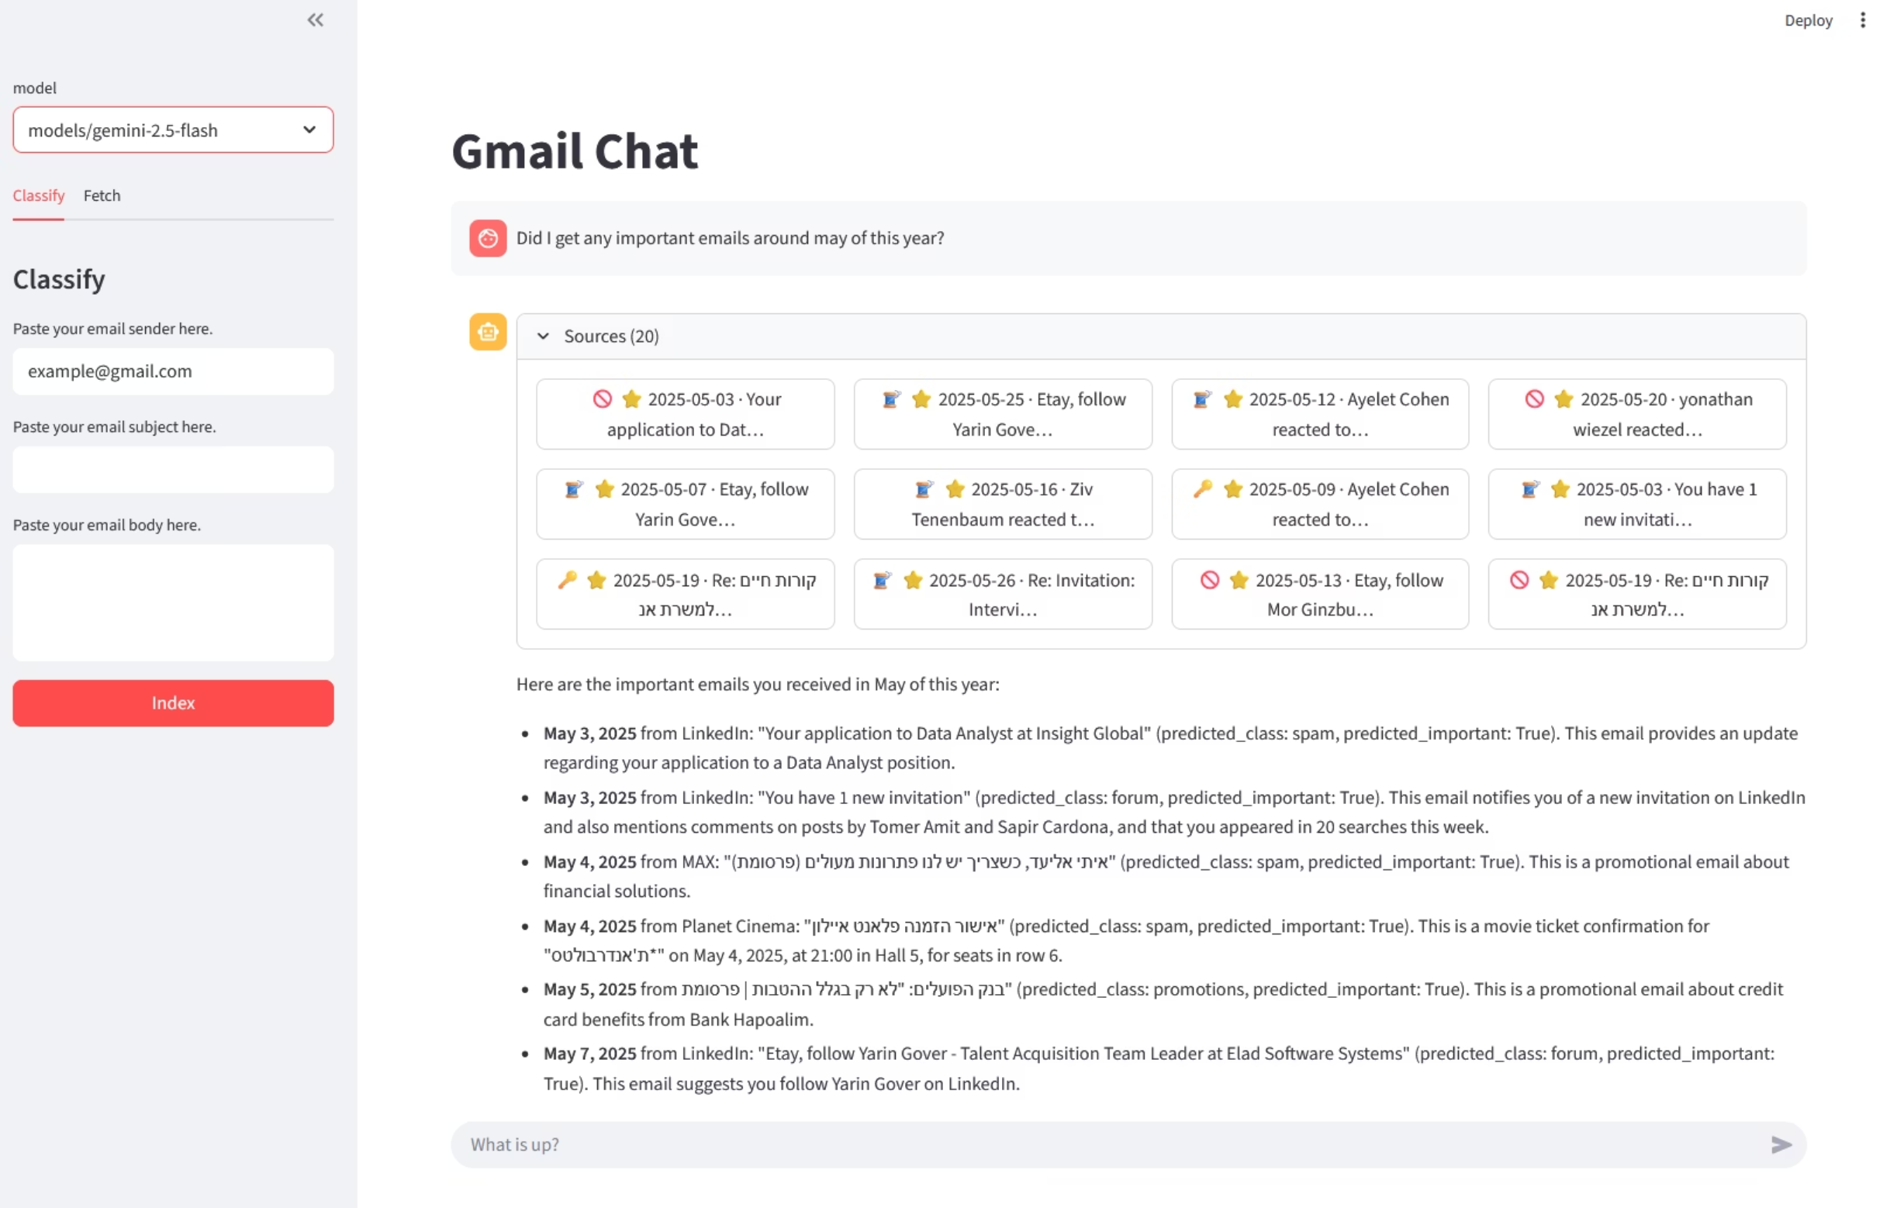

Slide 7

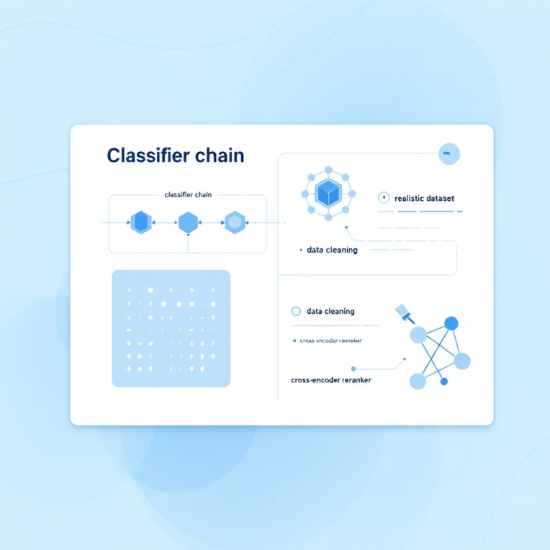
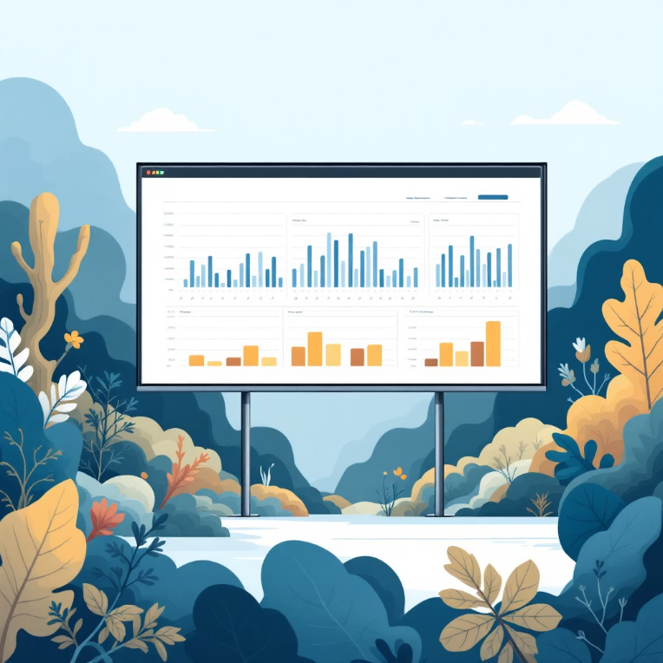

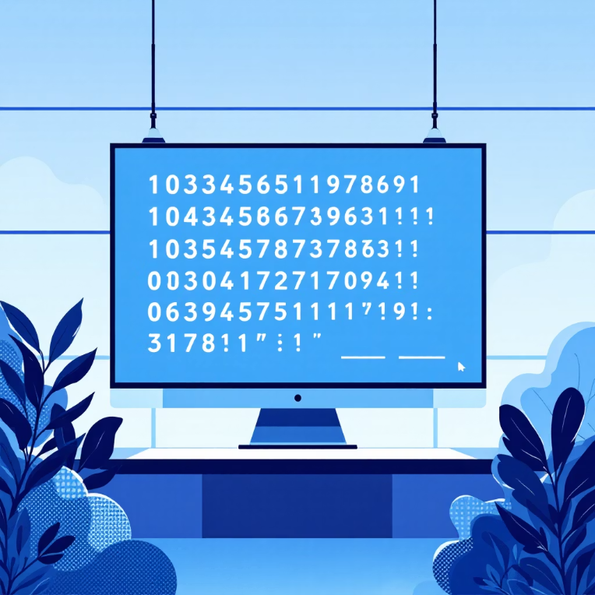
Future Work
Fixing Our Problems
Classifier Chain
Realistic Dataset
Data Cleaning
RAG Reranker
Implement classifier chain (importance head sees category probs) + penalize “spam & important”.
Current avg email ~19 words → short length hurts generalization.
Stronger preprocessing (clean HTML residue, Unicode).
Add cross-encoder reranker for more accurate retrieval.

